Slide 1
3.2.3 e - SUCCESSIONAL CHANGE
TEXT –
6.2 CHANGES IN NATURAL COMUNITIES

Slide 2
Learning intention Success criteria
e. Analyse ecological data to predict temporal and spatial successional changes
e. Use knowledge and understanding to recognise trends and draw conclusions from ecological data to give an expected result of an upcoming action/event; suggest what may happen based on available information about temporal and spatial successional changes

Slide 3
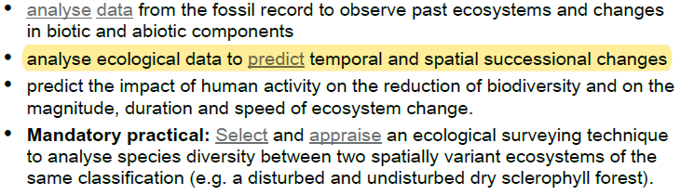
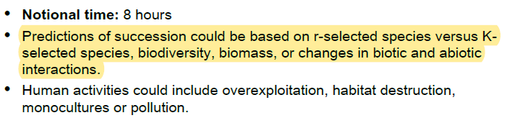
Syllabus check:
By the end of the lesson you should be able to…
NOTE SPECIFICALLY….

Slide 4
Predicting temporal and spatial changes in ecosystems
The nature of secondary succession depends on the original community and the nature of the disturbance. That is to say that the effect of a disturbance such as fire in a wet sclerophyll forest is completely different to its effect in a dry sclerophyll forest.
Succession is affected by the plants that invade or grow after a piece of land experiences disturbance. Successional changes in the producer communities can have flow on effects on the consumer communities, their densities and relationships.
Succession is affected by the plants that invade or grow after a piece of land experiences disturbance. There have been numerous studies on succession. Most are begun straight after a patch of land has been cleared or created. The data they provide has allowed ecologists to build up detailed models on haw succession progresses in different environments and after different kinds of disturbance.
Eg. Forest fires are common in Australia and forests have evolved to survive them. In many cases the forest can regrow within a few years, obtaining maximum recovery in a few decades. The number and diversity of fire adapted species present after a fire will influence secondary succession growth patterns. Regeneration may come from vegetative reproduction or seed growth. Further the intensity and speed as well as the regularity of the burns

Slide 5
Fire as a initiator of succession
Forest fires are common in Australia and in some cases forests have evolved to survive them. In many cases the forest can regrow within a few years, obtaining maximum recovery in a few decades. The number and diversity of fire adapted species present after a fire will influence secondary succession growth patterns. Regeneration may come from vegetative reproduction or seed growth. Further the intensity and speed as well as the regularity of the burns also effects the response of the ecosystem.
However if the forest burned is not fire adapted such as rainforests the effects of fire can be catastrophic and the climax community may not return for centuries.

Slide 6
Using data to predict changes
The table below shows the probability of the replacement of one individual tree by another of the same or different species in 100 years’ time after a sudden ecological disturbance.
 |  | Occupant in 100 years
Present occupant | Coastal Wattle (Acacia sophorae) | Black Butt (Eucalyptus pilularis) | Blue Gum (Eucalyptus tereticornis) | Red Mahogany (Eucalyptus robusta)
Coastal Wattle (Acacia sophorae) | 0.05 | 0.50 | 0.36 | 0.09
Black Butt (Eucalyptus pilularis) | 0.00 | 0.53 | 0.14 | 0.31
Blue Gum (Eucalyptus tereticornis) | 0.01 | 0.25 | 0.57 | 0.17
Red Mahogany (Eucalyptus robusta) | 0.00 | 0.03 | 0.01 | 0.96

Slide 7
 |  | Occupant in 100 years
Present occupant | Coastal Wattle (Acacia sophorae) | Black Butt (Eucalyptus pilularis) | Blue Gum (Eucalyptus tereticornis) | Red Mahogany (Eucalyptus robusta)
Coastal Wattle (Acacia sophorae) | 0.05 | 0.50 | 0.36 | 0.09
Black Butt (Eucalyptus pilularis) | 0.00 | 0.53 | 0.14 | 0.31
Blue Gum (Eucalyptus tereticornis) | 0.01 | 0.25 | 0.57 | 0.17
Red Mahogany (Eucalyptus robusta) | 0.00 | 0.03 | 0.01 | 0.96
Using the previous data table respond to the following questions.
1. Which species is most likely to replace Acacia sophorae in a 100-year temporal successional change in this forest? [1 mark]
2. Which species is most likely to replace Eucalyptus tereticornis in a 100-year temporal successional change in this forest? [1 mark]
3. Identify the species likely to be the equilibrium species at the end of the successional process. Justify your response. [2 marks]

Slide 8
Using data to predict changes EXTERNAL EXAM 202 MC 7
When predicting successional change, which of the following would typically indicate that an ecosystem is progressing toward its climax community?
 | Abundance of K-selected species | Biomass
(A) | Increasing | Decreasing
(B) | Decreasing | Increasing
(C) | Increasing | Increasing
(D) | Decreasing | Decreasing

Slide 9
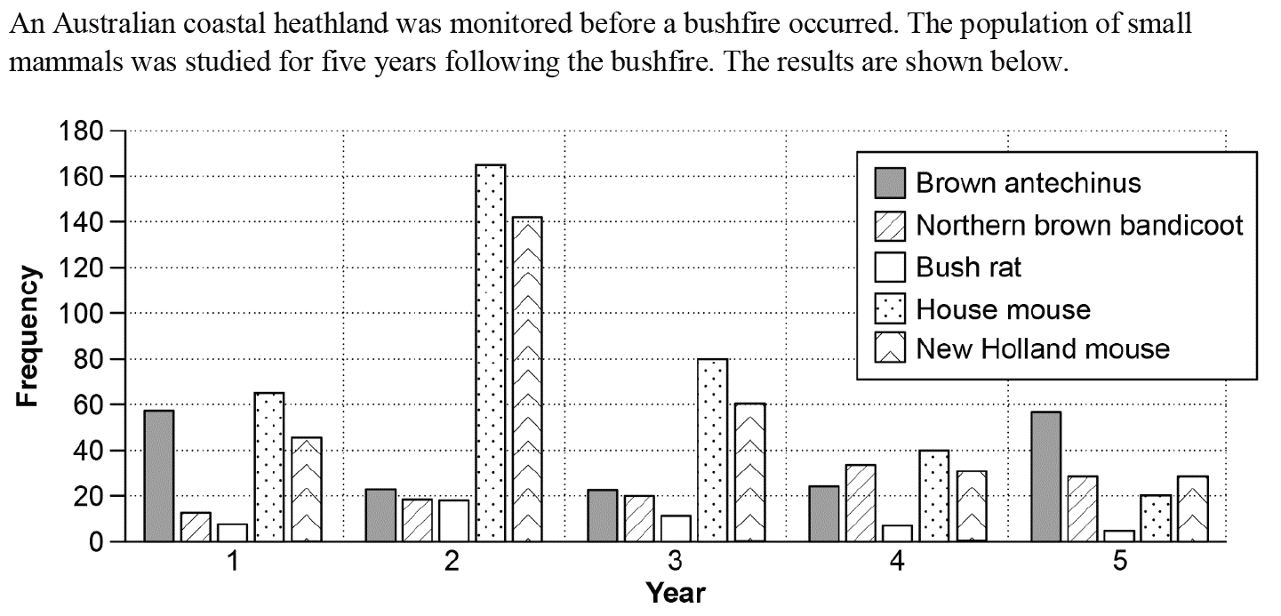
Exit ticket: e. Analyse ecological data to predict temporal and spatial Successional changes as well as (3.2.1 e - define ecological niche in terms of habitat, feeding relationships and interactions with other species) SO MOCKEXAM 2020 SA1 QUESTION 22 (5 marks)
a) Draw three conclusions about the successional relationships in this ecosystem. [3 marks]

Slide 10
b) Predict which mammal will be the most abundant in the sixth year after the bushfire. Give a reason. [2 marks]

